Slide 1


<Thomas Foss>
<November 27, 2023>

Slide 2

Outline
Executive Summary
Introduction
Methodology
Results
Conclusion
Appendix

Slide 3
Executive Summary
Summary of methodologies
Data Collection through API and web scraping
Data Wrangling
Exploratory Data Analysis with SQL and Data Visualization
Interactive Visual Analytics with Folium and Plotly
Machine Learning Prediction
Summary of all results
Useful data was available publicly
Using Exploratory Data Analysis, we were able to determine what features of the data were most useful in making predictions regarding launch success
Machine learning allowed us to determine the best predictive model for the collected data

Slide 4
Introduction
SpaceX has marketed the Falcon 9 rocket, a platform that trims the cost of conventional launch methods by more than $100 million. Much of the savings is due to the fact that SpaceX can reuse the first stage of the rocket in subsequent launches. In this project, we attempt to determine whether data science methodology can be used to help another company, SpaceY, make predictions regarding launch success and failure and thereby attempt to compete with SpaceX in the marketplace.
Problems you want to find answers
What factors determine if the rocket will land successfully?
Which feature or interacting features present in the available data are most useful in predicting the likelihood of a successful landing.
What operating conditions need to be present to ensure a successful landing program.

Slide 5

Section 1

Slide 6
Methodology
Executive Summary
Data collection methodology:
Data was collected using SpaceX API and web scraping from Wikipedia.
Perform data wrangling
One-hot encoding was applied to categorical features
Perform exploratory data analysis (EDA) using visualization and SQL
Perform interactive visual analytics using Folium and Plotly Dash
Perform predictive analysis using classification models
How to build, tune, evaluate classification models

Slide 7
Data Collection
Data was collected using the following methods
Data collection was performed using get request to the SpaceX API.
Response content was decoded as a Json using .json() function call and converted into a Pandas dataframe using .json_normalize().
We then performed data cleaning and (where necessary) filled in missing values.
In addition, we performed web scraping from Wikipedia for Falcon 9 launch records with BeautifulSoup.
The objective was to extract the launch records as HTML table, parse the table and convert it to a Pandas dataframe for future analysis

Slide 8
Data Collection – SpaceX API
Publicly available data was obtained via the SpaceX API and prepared for analysis
Source: https://github.com/tfoss78/Applied-Data-Science-Capstone/blob/main/jupyter-labs-spacex-data-collection-api.ipynb
Request API, parse SpaceX launch data
Filter data to show only Falcon 9 launches
Take steps to identify and replace missing values

Slide 9
Data Collection - Scraping
Additional data for SpaceX launches was obtained from the SpaceX Wikipedia site
Source: https://github.com/tfoss78/Applied-Data-Science-Capstone/blob/main/jupyter-labs-webscraping.ipynb
Falcon 9 launch data were requested from Wikipedia in HTML format
Data were then parsed and converted into a Pandas dataframe
HTML data were subsequently converted into a BeautifulSoup object

Slide 10
Data Wrangling
Performed exploratory data analysis
Determined number of launches per launch site, orbit occurrence and mission outcome occurrence
Source: https://github.com/tfoss78/Applied-Data-Science-Capstone/blob/main/labs-jupyter-spacex-Data%20wrangling.ipynb
Created “landing outcome” label from the outcome column and exported results to CSV

Slide 11
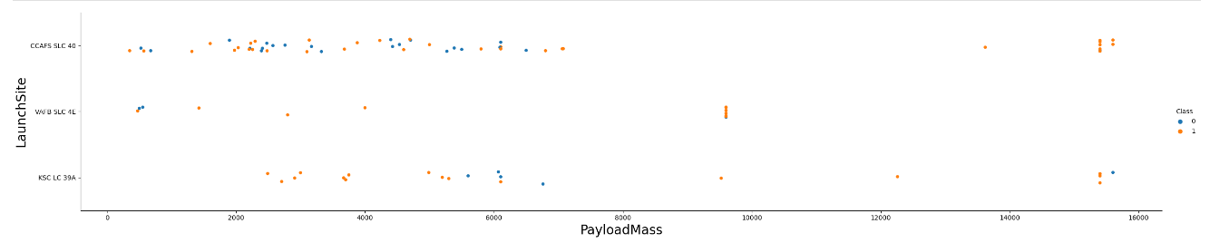
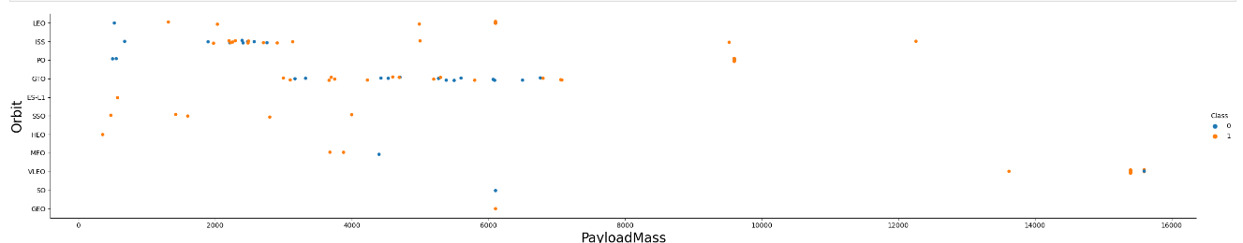
EDA with Data Visualization
The data were explored by visualizing the respective relationships between various data pairs (flight number and launch site, payload and launch site, orbit success and obit type, et al.)
Source: https://github.com/tfoss78/Applied-Data-Science-Capstone/blob/main/lab_jupyter_launch_site_location.jupyterlite.ipynb

Slide 12
EDA with SQL
Data were further explored using SQL queries as below:
Names of unique SpaceX launch sites
Top five launch sites beginning with the string “CCA”
Average payload mass for SpaceX booster F9 v1.1
Date of first successful landing
Names of boosters with payload mass 4,000-6,000 KG having successful drone-ship landings
Total mission successes and mission failures
Names of booster versions carrying the maximum payload mass
Failed outcomes by drone ship, booster version and launch site for the year 2015
Rank of landing failures and successes for the period 6/14/2004-3/20/2017
Source: https://github.com/tfoss78/Applied-Data-Science-Capstone/blob/main/jupyter-labs-eda-sql-coursera_sqllite.ipynb

Slide 13
Build an Interactive Map with Folium
Markers are used to identify important coordinate locations such as launch sites
Circles are used to identify important landmarks, such as NASA’s Johnson Space Center
Marker Clusters are used to indicate a series of events respective to a specific coordinate, such as to confirm the number of launches made from a specific launch site so as to distinguish sites by launch success rate
Lines are used to show distances between sets of coordinates
Source: https://github.com/tfoss78/Applied-Data-Science-Capstone/blob/main/lab_jupyter_launch_site_location.jupyterlite.ipynb

Slide 14
Build a Dashboard with Plotly Dash
A dashboard was created using Plotly dash to visualize data for launches by site and the respective ranges of different payloads
Visualizing data in this manner allowed us to analyze the relationship between payload and launch site, and further to identify the best launch site based on payload.
Source: https://github.com/tfoss78/Applied-Data-Science-Capstone/blob/main/spacex_dash_app.py

Slide 15
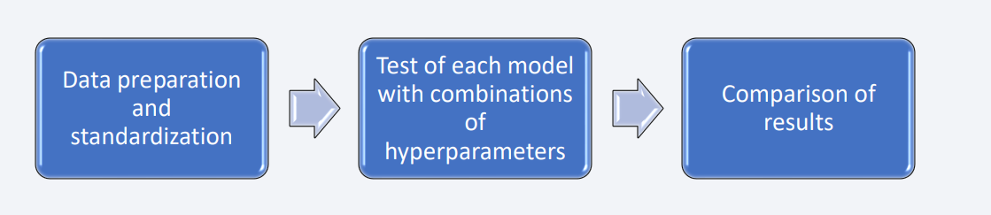
Predictive Analysis (Classification)
The data were run through four separate classification models (logistic regression, support vector machine, decision tree and K-nearest Neighbor) to determine which method would best predict future landing outcomes.
Source: https://github.com/tfoss78/Applied-Data-Science-Capstone/blob/main/SpaceX_Machine_Learning_Prediction_Part_5.jupyterlite.ipynb

Slide 16
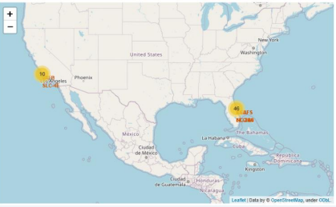
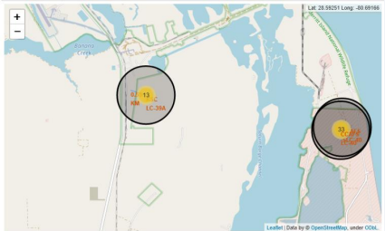
Results
Our use of exploratory data analysis showed that mission success has increased over time.
Our interactive analytics confirmed that launches are primarily conducted on the east coast and are most successful when taking place near the ocean and effective logistical infrastructure
Our use of predictive analysis determined that the Decision Tree classifier was most-effective at predicting successful landing results (84%)

Slide 17

Section 2

Slide 18
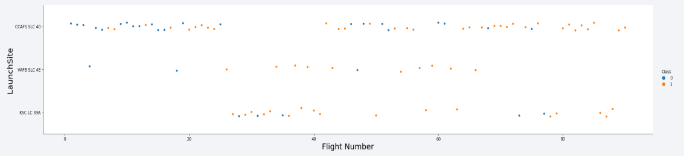
Flight Number vs. Launch Site
Based on recent results, the launch site with the highest success rate is CCAF5 SLC 40
Success rate for all sites has increased over time.

Slide 19
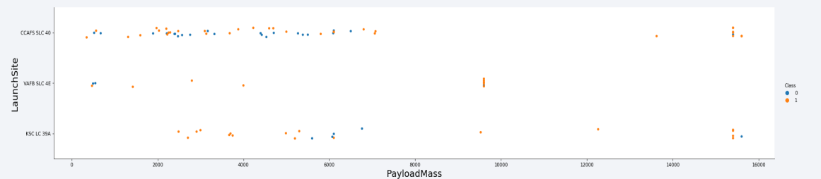
Payload vs. Launch Site
Payloads below 9,000kg are very likely to be successful
Payloads in excess of 12,000kg have a lower success rate and launches of payloads this size are inadvisable at the VAF8 SLC 4E

Slide 20
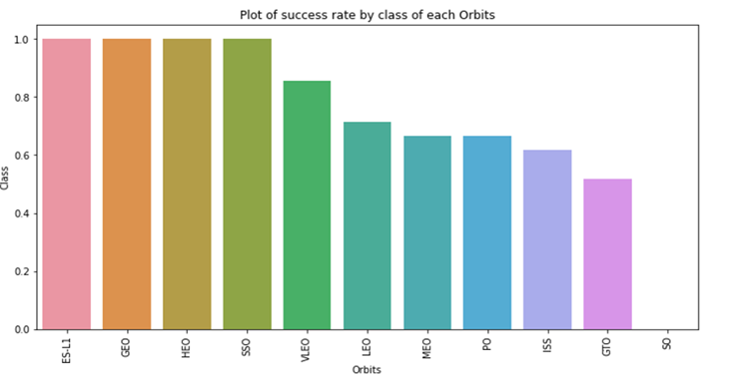
Success Rate vs. Orbit Type
Based on the results shown on this chart, the sites with the highest success rate are ES-L1, GE0, HE0 and SS0

Slide 21
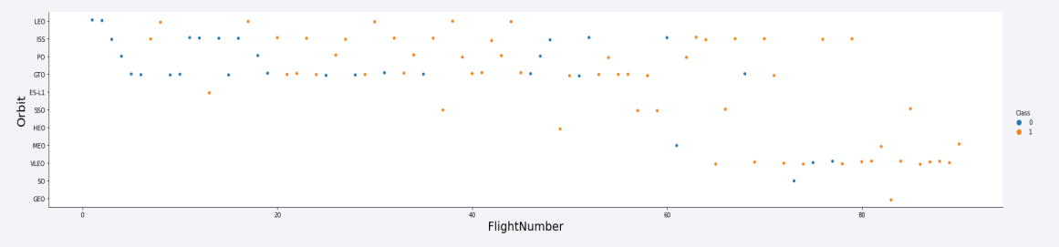
Flight Number vs. Orbit Type
The success rate of all orbit types has improved over time
VLEO orbit is a new type

Slide 22
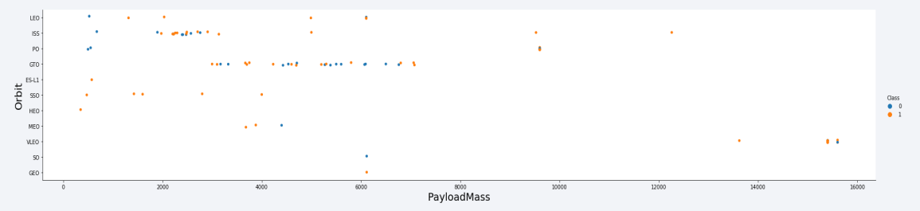
Payload vs. Orbit Type
The success of the ISS orbit type seems to be affected very little by payload

Slide 23
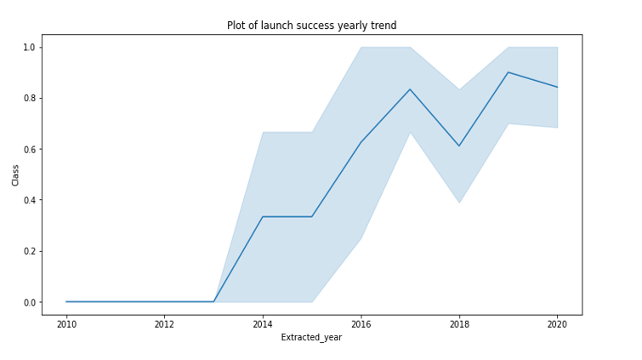
Launch Success Yearly Trend
We note that success has increased over time

Slide 24
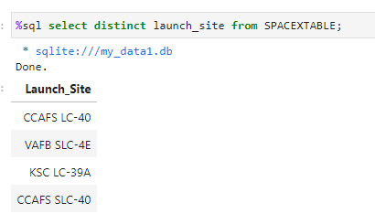
All Launch Site Names
The number of unique launch sites (four total) was determined using the query shown below

Slide 25
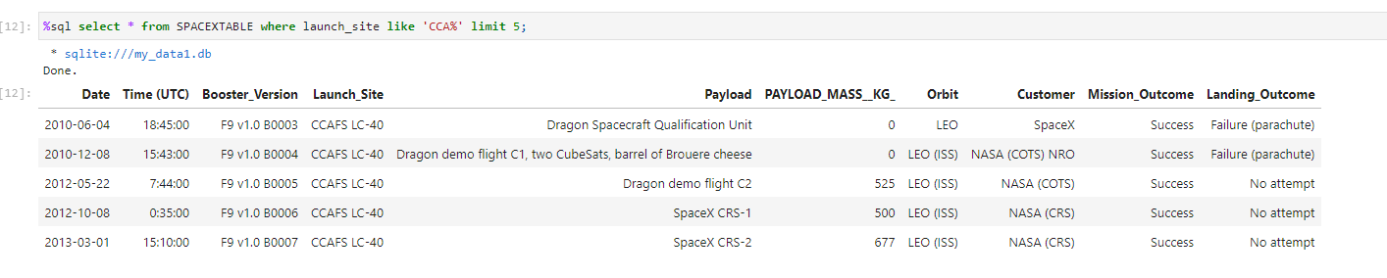
Launch Site Names Begin with 'CCA'
Below shows the query whereby we were able to identify five records for launch sites beginning with the string “CCA”

Slide 26
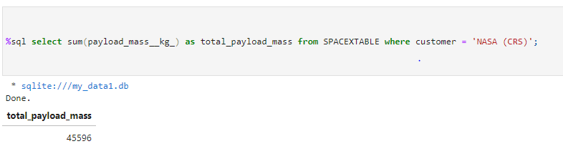
Total Payload Mass
The query below shows the calculated total mass of boosters launched by NASA

Slide 27
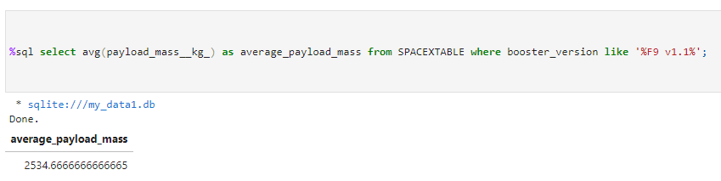
Average Payload Mass by F9 v1.1
Below is a query that calculates the average payload mass as carried by booster F9 v1.1

Slide 28
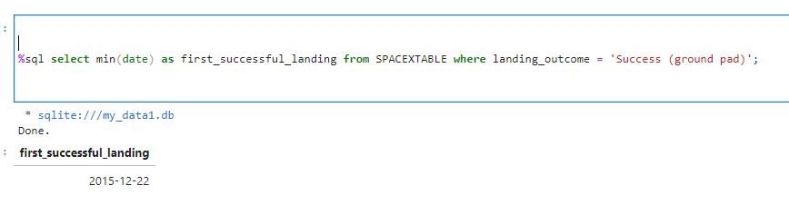
First Successful Ground Landing Date
The first successful landing was achieved on December 22, 2015

Slide 29
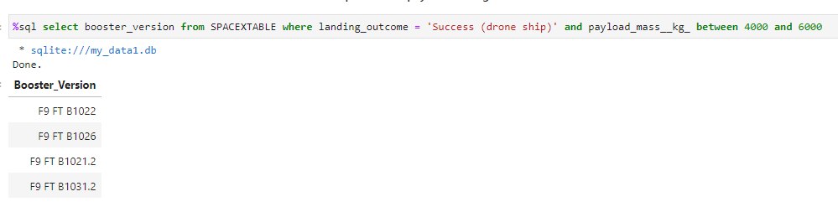
Successful Drone Ship Landing with Payload between 4000 and 6000
The following query confirms missions that landed on drone ship and had payload mass greater than 4000 but less than 6000

Slide 30
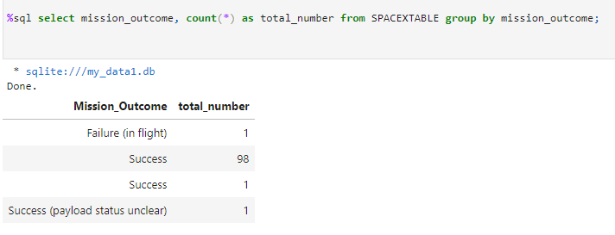
Total Number of Successful and Failure Mission Outcomes
Below is a query that confirms the total number of successful and failure mission outcomes

Slide 31
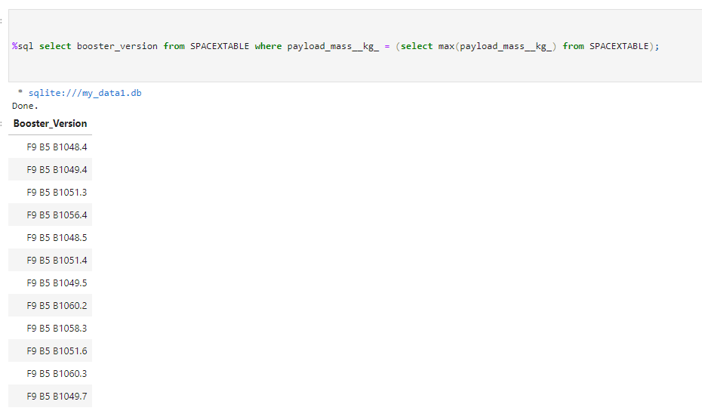
Boosters Carried Maximum Payload
Below are the boosters which have carried the maximum payload mass

Slide 32
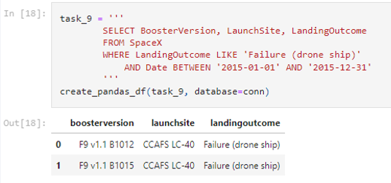
2015 Launch Records
Below are the failed landing outcomes in drone ship, their booster versions, and launch site names for in year 2015

Slide 33
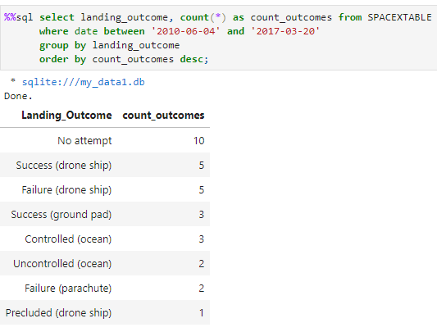
Rank Landing Outcomes Between 2010-06-04 and 2017-03-20
The query below ranks the count of landing outcomes (such as Failure (drone ship) or Success (ground pad)) between the date 2010-06-04 and 2017-03-20, in descending order

Slide 34

Section 3

Slide 35
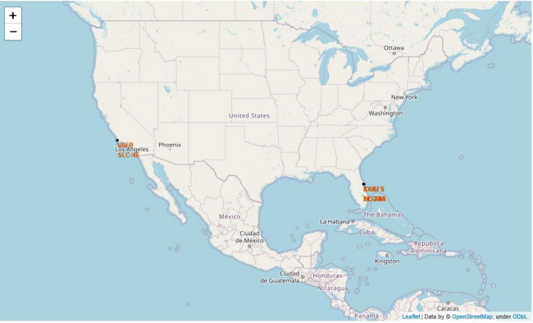
Launch Sites
As we see from this map showing all launch sites, sites are clustered in southern, coastal areas with generally mild weather conditions

Slide 36
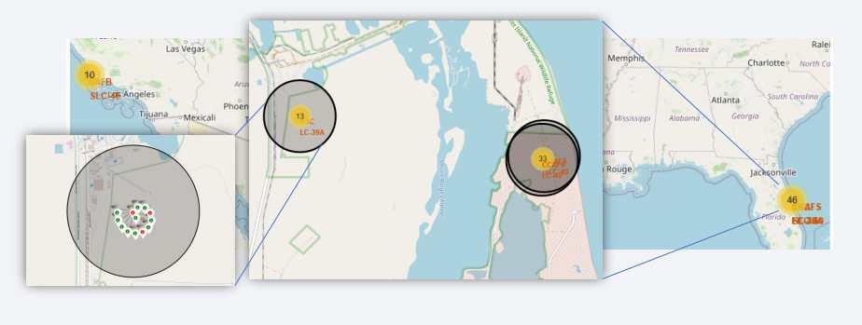
Launch Outcomes: KSC LC-39A
From this test data, we see that successful launches are shown in green, failures in red.

Slide 37
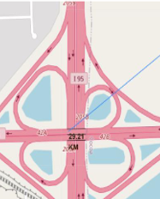
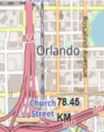
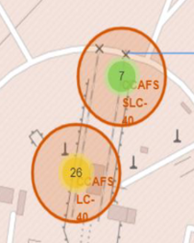
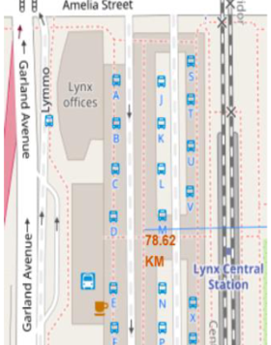
Proximity of Sites to Significant Geographical Factors
We see that launch sites are typically located in coastal areas at a reasonable distance from populated areas, are furthermore not typically in close proximity to highways or railroads

Slide 38

Section 4

Slide 39
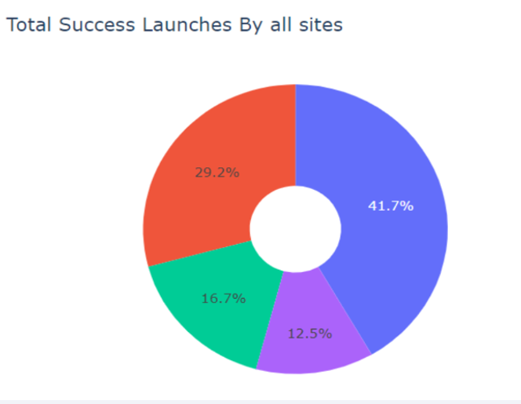
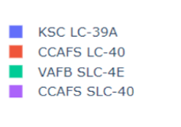
Plotly: Success Percentages
The chart below shows that the KSC LC-39A site had by far the highest rate of successful launches

Slide 40
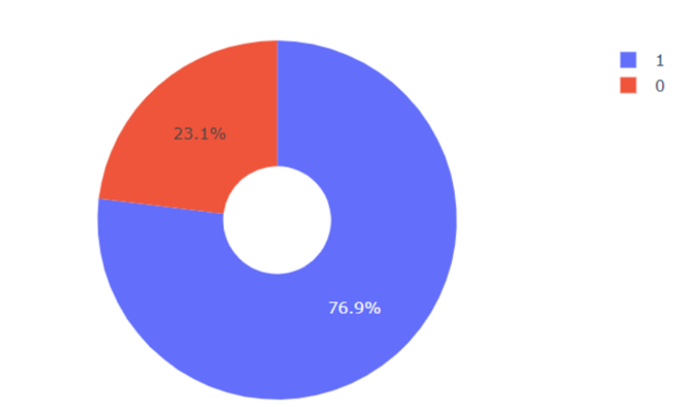
Launch Site with Highest Success Percentage
We see that KSC LC-39A had the highest success-to-failure ratio

Slide 41
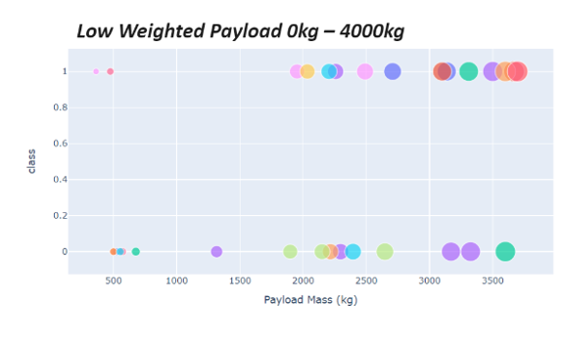
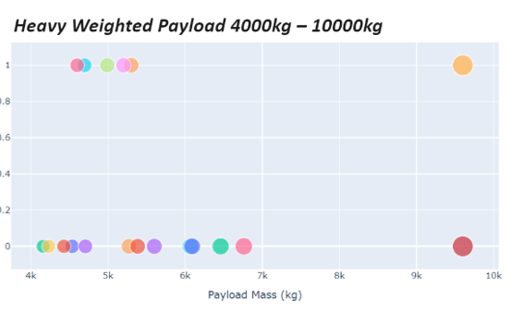
Payload vs. Launch Outcome: All Sites
Current data confirm a higher rate of success for lighter payloads vs. heavier payloads

Slide 42

Section 5

Slide 43
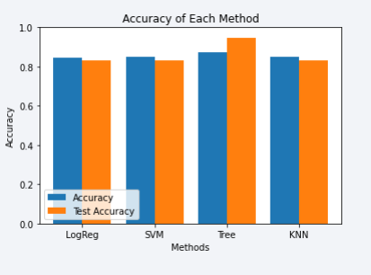
Classification Method Accuracy
Of the four classification methods tested, the Decision Tree classifier was determined to be the most accurate means of prediction

Slide 44
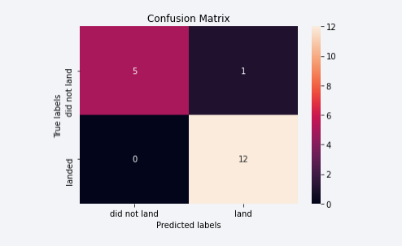
Confusion Matrix
Below is the Confusion Matrix for the Decision Tree classifier.

Slide 45
Conclusions
As the number of launches for a given site increase, the rate of success similarly increase
The KSC LC-39A sites had the highest rate of launch success among the group
Launches with smaller payloads tend to be more successful
The Decision Tree classifier was the most useful method of analyzing this particular data set.

Slide 46


